Slide 1


Nutan Maharashtra Vidya Prasarak Mandal’s NUTAN COLLEGE OF ENGINEERING AND RESEARCH Under Administrative Support of Pimpri Chinchwad Education Trust ISO 21001:2018 EOMS Certified
Project Exhibition
Presentation on
“ Hybrid Deep Learning for Cyclone Intensity Estimation using Multi-Source Satellite Data ”
By
Aman Maner (26)
Pratik Gade (28)
Arpita Phalke (43)
Kirti Rachkar (47)
Under the guidance of
Prof. Priyanka Vyas
Department of Computer Science Engineering - Artificial Intelligence
Friday, 02 May 2025

Slide 2
Nutan Maharashtra Vidya Prasarak Mandal’s NUTAN COLLEGE OF ENGINEERING AND RESEARCH Under Administrative Support of Pimpri Chinchwad Education Trust ISO 21001:2018 EOMS Certified
Project Exhibition
Introduction :
Problem Statement:
Cyclones form over warm ocean waters (≥26.5°C) with high humidity and low vertical wind shear.
Rising moist air creates a low-pressure system that rotates due to the Coriolis effect.
Accurately predicting cyclone intensity early is difficult due to unclear storm centers.
Traditional models rely on manual techniques and lack real-time responsiveness.
This project uses multi-source satellite imagery and features like optical flow, cloud asymmetry, and cold cloud top variation.
A hybrid deep learning model (CNN + Transformer) is employed for accurate, real-time cyclone intensity estimation.
Cyclones in the Indian Ocean cause major damage to life and property.
Current models:
Struggle to provide real-time updates.
Are often trained on non-local datasets, affecting regional accuracy.
Have limited interpretability and are not user-friendly.
Difficulty in processing large-scale satellite data and presenting insights delays response efforts.
Lack of localized, dynamic prediction models risks ineffective disaster management.

Slide 3
Nutan Maharashtra Vidya Prasarak Mandal’s NUTAN COLLEGE OF ENGINEERING AND RESEARCH Under Administrative Support of Pimpri Chinchwad Education Trust ISO 21001:2018 EOMS Certified
Project Exhibition
Problem Solution :
Developed a hybrid AI model combining CNN and Vision Transformer for cyclone intensity prediction.
Utilizes multi-source satellite data and seven handcrafted meteorological features.
Employs transfer learning to adapt global models for the Indian Ocean region.
Real-time system integrated with FastAPI backend and a web interface for visualization.
Enables faster decision-making and improves trust in AI-driven cyclone forecasting.

Slide 4
Nutan Maharashtra Vidya Prasarak Mandal’s NUTAN COLLEGE OF ENGINEERING AND RESEARCH Under Administrative Support of Pimpri Chinchwad Education Trust ISO 21001:2018 EOMS Certified
Project Exhibition
Objectives :
To collect and preprocess multi-source satellite imagery and atmospheric data for cyclones across the Indian Ocean.
To implement hybrid deep learning architectures combining Convolutional Neural Networks (CNNs) with transformer-based models for cyclone intensity estimation.
To evaluate and validate the performance of the developed deep learning model for cyclone intensity prediction using metrics such as root mean squared error (RMSE)
To explore transfer learning techniques by fine-tuning pre-trained global cyclone models for Indian Ocean-specific cyclone intensity estimation.
To develop a dynamic real-time deep learning model that updates cyclone intensity estimates using real-time satellite imagery.
To develop a web interface and interpretable AI models that provide result for their predictions of cyclone intensity, enhancing trust and usability for meteorologists.

Slide 5
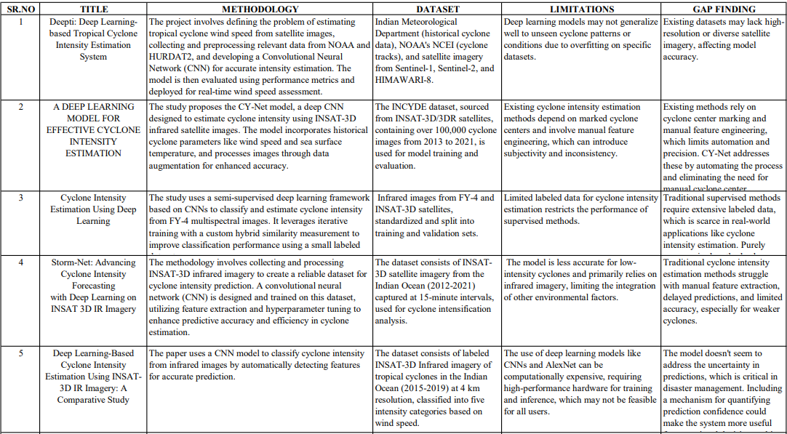
Nutan Maharashtra Vidya Prasarak Mandal’s NUTAN COLLEGE OF ENGINEERING AND RESEARCH Under Administrative Support of Pimpri Chinchwad Education Trust ISO 21001:2018 EOMS Certified
Project Exhibition
Literature survey table

Slide 6
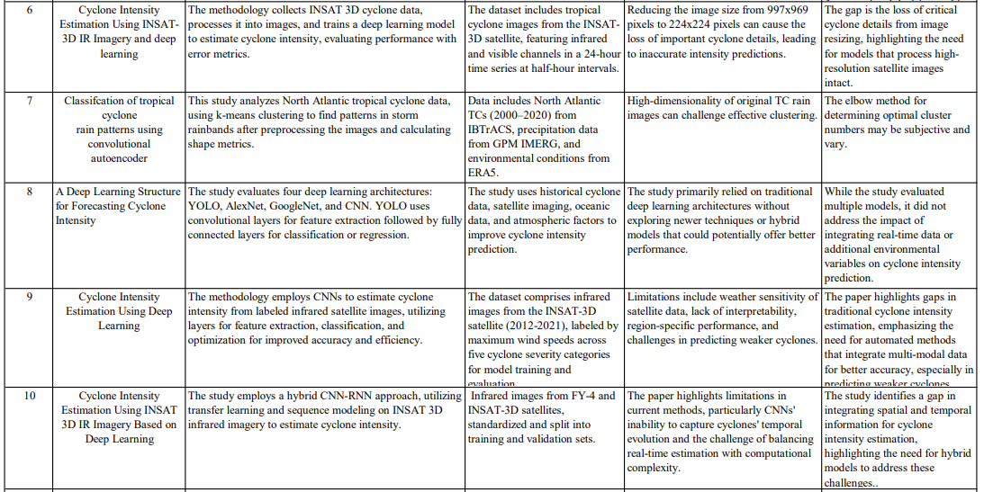
Nutan Maharashtra Vidya Prasarak Mandal’s NUTAN COLLEGE OF ENGINEERING AND RESEARCH Under Administrative Support of Pimpri Chinchwad Education Trust ISO 21001:2018 EOMS Certified
Project Exhibition

Slide 7
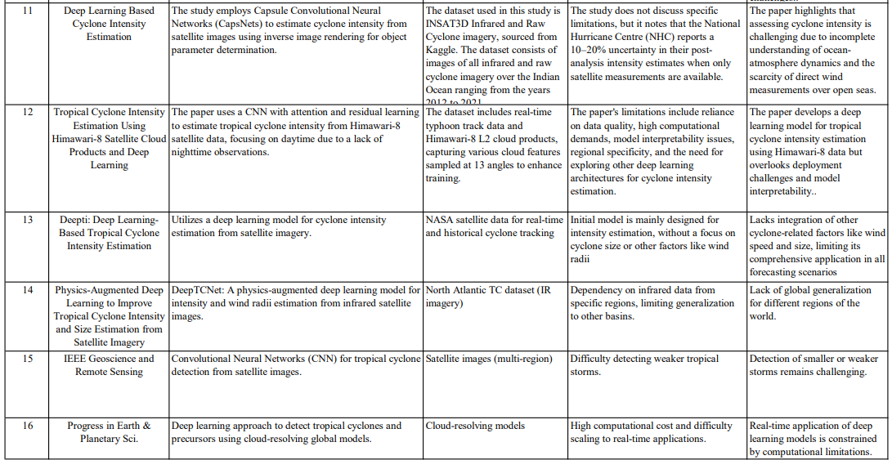
Nutan Maharashtra Vidya Prasarak Mandal’s NUTAN COLLEGE OF ENGINEERING AND RESEARCH Under Administrative Support of Pimpri Chinchwad Education Trust ISO 21001:2018 EOMS Certified
Project Exhibition

Slide 8
Nutan Maharashtra Vidya Prasarak Mandal’s NUTAN COLLEGE OF ENGINEERING AND RESEARCH Under Administrative Support of Pimpri Chinchwad Education Trust ISO 21001:2018 EOMS Certified
Project Exhibition
Dataset Comparison Table
Sr. No. | Name | Interval | Description | regions | Source | Link
1 | INSAT3D Infrared & Raw Cyclone Imagery | 2012-2021 | Image Dataset containing all INSAT3D captured INFRARED and RAW Cyclone Imagery over the Indian Ocean fronm 2012 to 2021 along with each Cyclone Image intensity in KNOTS. The Raw Data has been sourced from the MOSDAC server and I have labelled each Image by locating the timestamp with its respective coordinate in the intensity-time graph of each cyclone directory. | Indian Ocean | Kaggle | https://www.kaggle.com/datasets/sshubam/insat3d-infrared-raw-cyclone-images-20132021?select=insat_3d_ds+-+Sheet.csv
2 | INSAT3D Infrared & Raw Cyclone Imagery | 2012-2022 |  | Indian Ocean | MOSDAC server | https://mosdac.gov.in/cyclone-genesis/archive/
3 | The Imperial College Storm Model (IRIS) Dataset | 1980-2021 | The IRIS dataset is based on the mean of the 42-year input observations. The 10,000 year output is fixed to the “current” 1980–2021 TC climate rather than a prediction of any sort. The IRIS model produces independent synthetic years, so the dataset has no inter-annual correlation which may be important for some applications, for example, calculating multi-year risk. The magnitude of the inter-annual variability in the dataset resembles that of the 42-year observation period which may not contain the full range of the multidecadal variability of the Earth climate system. | U.S. | International Best Track Archive for Climate Stewardship (IBTrACS, v04r00) World Meteorological Organisation data | https://github.com/njsparks/iris & https://www.nature.com/articles/s41597-024-03250-y#Abs1
4 | NOAA-Himawari-Dataset | 2014-2021 | Himawari-8, stationed at 140E, owned and operated by the Japan Meteorological Agency (JMA), is a geostationary meteorological satellite, with Himawari-9 as on-orbit back-up, that provides constant and uniform coverage of east Asia, and the west and central Pacific regions from around 35,800 km above the equator with an orbit corresponding to the period of the earth’s rotation. This allows JMA weather offices to perform uninterrupted observation of environmental phenomena such as typhoons, volcanoes, and general weather systems. | east Asia, and the west and central Pacific regions | Japan Meteorological Agency (JMA) | https://dagshub.com/DagsHub-Datasets/noaa-himawari-dataset
5 | Geo-KOMPSAT-2A (GK2A) satellite data | 2019-2023 | Geo-KOMPSAT-2A (GK2A) is a geostationary satellite operated by the Korea Meteorological Administration (KMA) and is part of South Korea's meteorological satellite program. It was launched in 2018 and provides real-time weather and environmental monitoring data, primarily for the Asia-Pacific region. GK2A is equipped with the Advanced Meteorological Imager (AMI), which captures high-resolution imagery used for weather forecasting, disaster monitoring, and environmental assessment. | western North Pacific | KMA (Korea Meteorological Administration) | https://registry.opendata.aws/noaa-gk2a-pds/
6 | Communication, Ocean, and Meteorological Satellite (COMS) data | 2011–2019 | COMS (Communication, Ocean, and Meteorological Satellite), also known as Chollian-1, is South Korea’s first multi-purpose geostationary satellite launched by KARI (Korea Aerospace Research Institute) in 2010. It provides data for meteorological monitoring, ocean observation, and communication services, mainly for the Asia-Pacific region. | Asia-Pacific region,Korean Peninsula, East Asia, Southeast Asia, and parts of the Western Pacific and Indian Ocean. | KMA (Korea Meteorological Administration) | https://catalog.data.gov/dataset/coms-geostationary-ocean-color-imager-goci-ocean-color-oc-regional-data

Slide 9
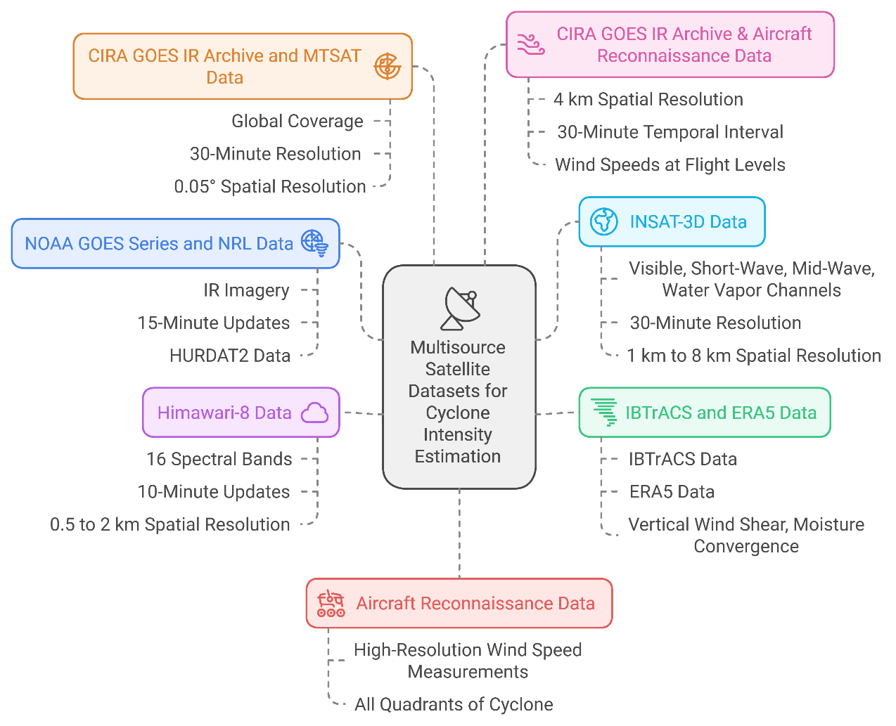
Nutan Maharashtra Vidya Prasarak Mandal’s NUTAN COLLEGE OF ENGINEERING AND RESEARCH Under Administrative Support of Pimpri Chinchwad Education Trust ISO 21001:2018 EOMS Certified
Project Exhibition
Fig.1: Multisource Satellite Dataset Classification

Slide 10
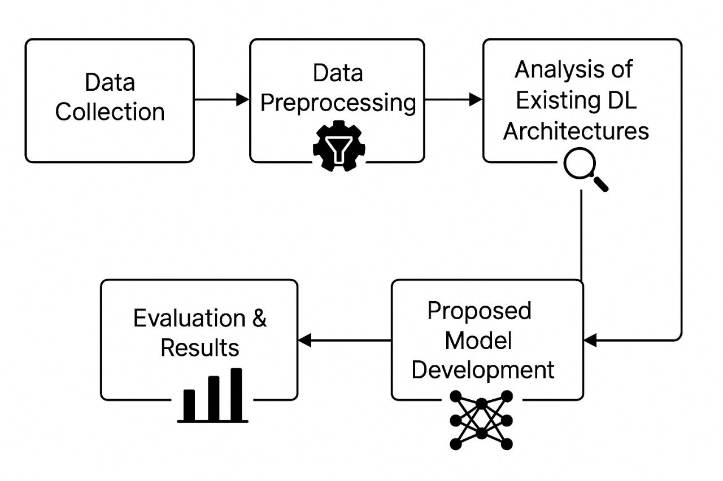
Nutan Maharashtra Vidya Prasarak Mandal’s NUTAN COLLEGE OF ENGINEERING AND RESEARCH Under Administrative Support of Pimpri Chinchwad Education Trust ISO 21001:2018 EOMS Certified
Project Exhibition
System Architecture :
Fig.2 : End-to-End System Architecture for Cyclone Intensity Estimation

Slide 11
Nutan Maharashtra Vidya Prasarak Mandal’s NUTAN COLLEGE OF ENGINEERING AND RESEARCH Under Administrative Support of Pimpri Chinchwad Education Trust ISO 21001:2018 EOMS Certified
Project Exhibition
Model Development:
On the local system, the raw data is transformed into annotated images, which are used for training the model.
The system includes a Cyclone Detector that identifies cyclone images as well as video and a Cyclone Intensity Classifier that classifies the strength of the cyclone.
These steps result in labelled images that are used to train and improve the model. The model is then stored in a database (Amazon DynamoDB).
Backend:
Live data from the AWS server is transformed and fed into the system's Cyclone Detector and Intensity Classifier using the pre-trained model stored in the database.
This step allows real-time detection and classification of cyclone intensities.
Frontend:
Users can upload data, and the system processes this data using the same model to detect cyclones and estimate their intensity.
The results are rendered and displayed for the users in an easy-to-understand format.
Overall, this flow shows how cyclone data is collected, processed, and used to predict cyclone intensities in real-time while allowing users to interact with the system through a front-end interface

Slide 12
Nutan Maharashtra Vidya Prasarak Mandal’s NUTAN COLLEGE OF ENGINEERING AND RESEARCH Under Administrative Support of Pimpri Chinchwad Education Trust ISO 21001:2018 EOMS Certified
Project Exhibition
Experimental Results :
Sr.No. | Algorithm | RMSE | MSE | MAE | LOSS
1] | Alex net | 22.93 | 525.14 | 28.73 | 17.21
2] | DenseNet | 31 | 961.00 | 38.84 | 26.82
3] | InceptionV3 | 61 | 3721.00 | 76.44 | 58
4] | Mobilenet | 61.96 | 3840.24 | 77.61 | 57.94
5] | Resnet50 | 58.66 | 3440.66 | 77.55 | 50.61
6] | Vgg | 19.34 | 374.00 | 24.23 | 14.87

Slide 13
Nutan Maharashtra Vidya Prasarak Mandal’s NUTAN COLLEGE OF ENGINEERING AND RESEARCH Under Administrative Support of Pimpri Chinchwad Education Trust ISO 21001:2018 EOMS Certified
Project Exhibition
Fig.4 : Comparison of Various Deep Learning Models on Satellite Dataset

Slide 14
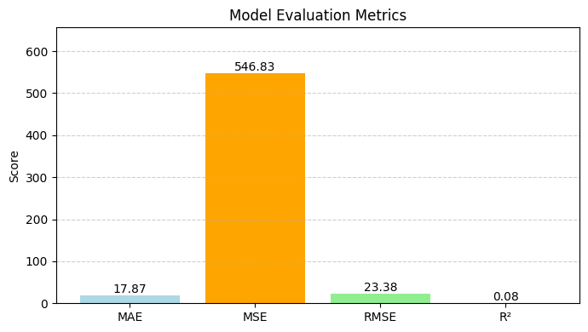
Nutan Maharashtra Vidya Prasarak Mandal’s NUTAN COLLEGE OF ENGINEERING AND RESEARCH Under Administrative Support of Pimpri Chinchwad Education Trust ISO 21001:2018 EOMS Certified
Project Exhibition
Hybrid ViT + 7 Extra Features (Enhanced) Evaluation
To improve cyclone intensity estimation, we enhanced the Vision Transformer (ViT) model by integrating seven domain-specific features alongside image inputs. These features capture both spatial and meteorological patterns crucial for accurate predictions:
Latitude and Longitude – to account for location-based cyclone behaviour.
Sea Surface Temperature (SST) – primary driver of cyclone energy.
Cloud Asymmetry Index (CAI) – indicates storm structure imbalance.
Cold Cloud Top Variation (CCTV) – reflects convection intensity.
Optical Flow – estimates wind field motion.
Time Since Formation – gives temporal context.
Cyclone Type – helps differentiate between depressions, storms, etc.
Fig.5 : Model Evaluation Metrics
The hybrid model fuses ViT's spatial understanding with these engineered features using a dense fusion layer, resulting in improved prediction accuracy and robustness.

Slide 15
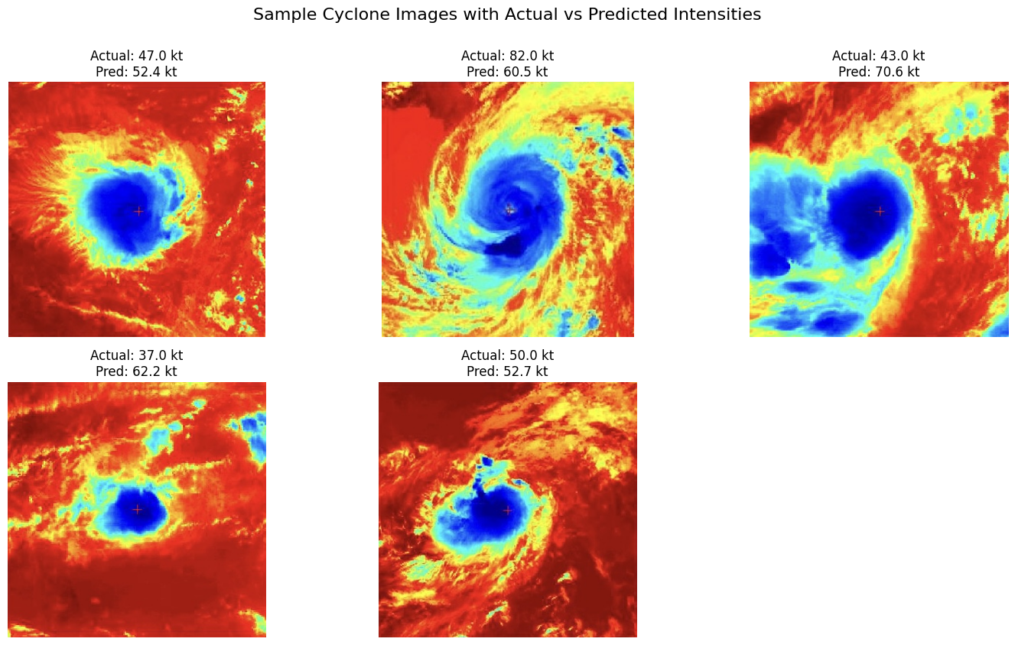
Nutan Maharashtra Vidya Prasarak Mandal’s NUTAN COLLEGE OF ENGINEERING AND RESEARCH Under Administrative Support of Pimpri Chinchwad Education Trust ISO 21001:2018 EOMS Certified
Project Exhibition
Fig.6 :Sample Cyclone Images with Actual vs Predicted Intensities

Slide 16
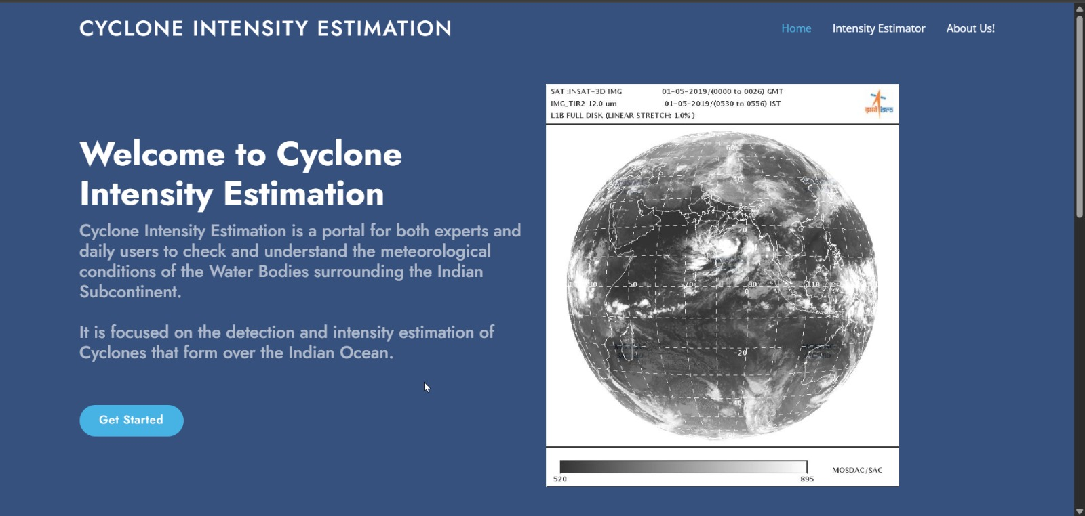
Nutan Maharashtra Vidya Prasarak Mandal’s NUTAN COLLEGE OF ENGINEERING AND RESEARCH Under Administrative Support of Pimpri Chinchwad Education Trust ISO 21001:2018 EOMS Certified
Project Exhibition
Web application :
Fig.7 : Main web interface

Slide 17
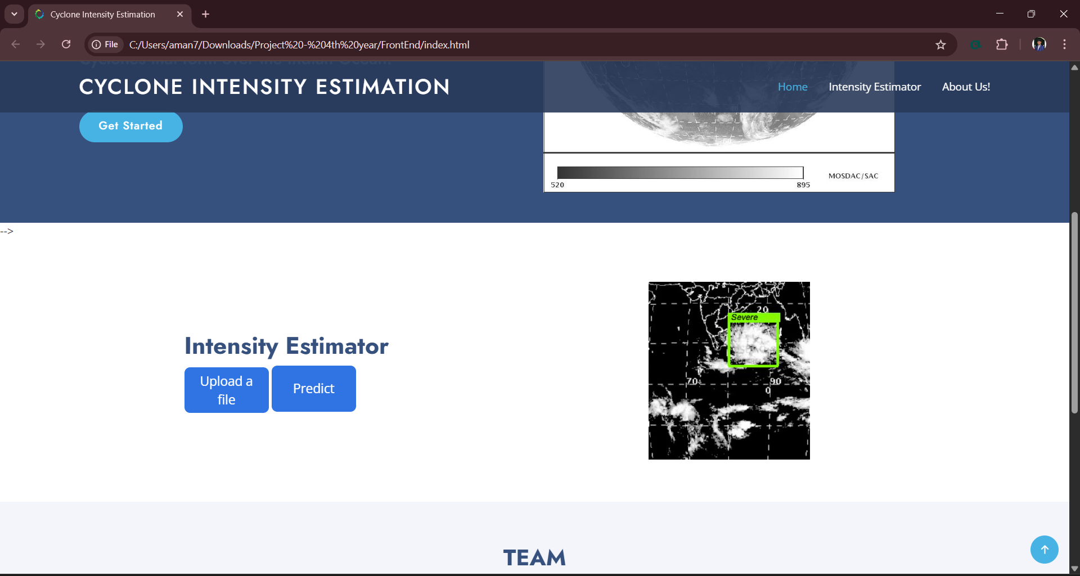
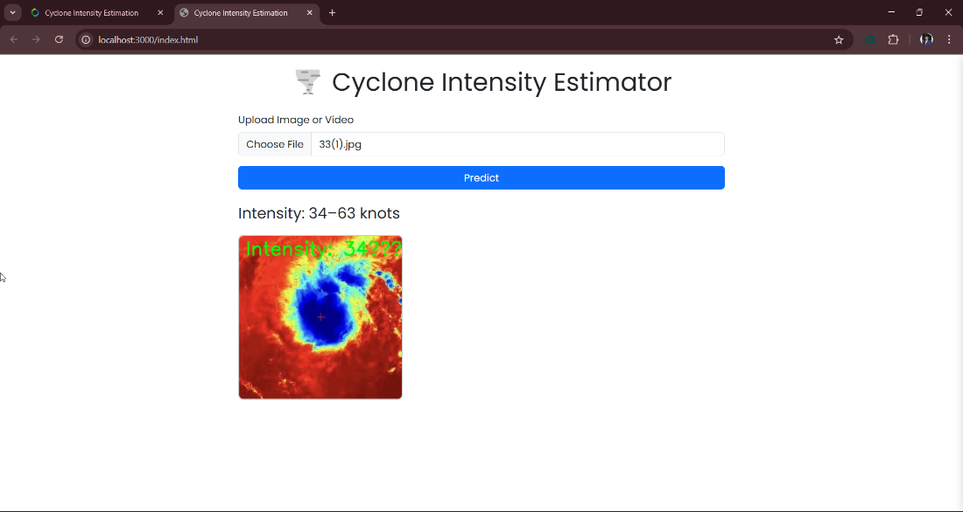
Nutan Maharashtra Vidya Prasarak Mandal’s NUTAN COLLEGE OF ENGINEERING AND RESEARCH Under Administrative Support of Pimpri Chinchwad Education Trust ISO 21001:2018 EOMS Certified
Project Exhibition
A user-friendly web interface was developed to visualize real-time cyclone intensity predictions.
Built using HTML, CSS, and JavaScript for a responsive frontend.
Integrated with a FastAPI backend for handling prediction requests.
Users can upload satellite images and view intensity estimates instantly.
The system is currently deployed on localhost for testing and demonstration.
Fig.7 : Specified web page for Cylone Intensity Estimation

Slide 18
Nutan Maharashtra Vidya Prasarak Mandal’s NUTAN COLLEGE OF ENGINEERING AND RESEARCH Under Administrative Support of Pimpri Chinchwad Education Trust ISO 21001:2018 EOMS Certified
Project Exhibition
Outcome for Society:
Accurate cyclone intensity prediction is critical for minimizing the impact of natural disasters on vulnerable populations. Our system contributes to public safety and disaster resilience through
the following outcomes:
Timely alerts that help save lives and reduce infrastructure damage.
Decision support for disaster management authorities and local governments.
Public awareness through accessible real-time information.
Support for researchers in advancing climate and weather modeling.
Promotes technological solutions for social good in climate resilience efforts.

Slide 19
Nutan Maharashtra Vidya Prasarak Mandal’s NUTAN COLLEGE OF ENGINEERING AND RESEARCH Under Administrative Support of Pimpri Chinchwad Education Trust ISO 21001:2018 EOMS Certified
Project Exhibition
Conclusion :
The developed cyclone intensity prediction model effectively integrates Vision Transformer (ViT) for feature extraction, enabling accurate and real-time cyclone monitoring. By processing raw cyclone satellite imagery and incorporating advanced features like optical flow, Cloud Asymmetry Index (CAI), and Cold Cloud Top Variation (CCTV), the model significantly enhances prediction accuracy. The predicted cyclone intensity values (in knots) closely align with actual observations, making this approach highly suitable for meteorological agencies and disaster management systems.
Future Work:
Incorporate more meteorological sensors for enriched data input.
Use 3D satellite data for better spatial context and analysis.
Improve model resilience against noise and environmental variability.
Enhance real-time prediction capabilities for faster response.

Slide 20
Nutan Maharashtra Vidya Prasarak Mandal’s NUTAN COLLEGE OF ENGINEERING AND RESEARCH Under Administrative Support of Pimpri Chinchwad Education Trust ISO 21001:2018 EOMS Certified
Project Exhibition
References:
[1] Manil Maskey,”Deepti: Deep Learning-based Tropical Cyclone In- tensity Estimation System,” JOURNAL OF SELECTED TOPICS IN APPLIED EARTH OBSERVATIONS AND REMOTE SENSING, 2024.
[2] Narendra Babu Alur, Supraja K.S.V,Praneetha A,Manoj G.,Kota Lokesh G.,Sivarama Sreekari T, Brahmanandam P. S., ”A DEEP LEARNING MODEL FOR EFFECTIVE CYCLONE INTENSITY ESTIMATION,” Journal of Engineering, Management and Information Technology, Vols. Vol. 02, No. 03 (2024) 161-160, doi:10.61552/JEMIT.2024.03.007 - http://jemit.aspur.rs, 2024.
[3] D. Yella Krishna, T. Praveen,Ch. Sathvika ,Ch. NVD Navya, ”Cyclone Intensity Estimation Using Deep Learning,” J. Electrical Systems, 2024.
[4] Santoshi Borapareddy, Susrutha Morishetty, Charitha Boda and K.Swathi,, ”Storm-Net: Advancing Cyclone Intensity Forecasting with Deep Learning on INSAT 3D IR Imagery,” Grenze International Journal of Engineering and Technology, 2024.
[5] Harshal Namdeorao Dharpure, Tejal Sudhakarrao Mohod, Radhika Vinod Malani,Janhavi Chandak, Atharva Shekhar Belge, Preet Ravin Ambadkar, Prof Ankita Pande, ”Deep Learning-Based Cyclone Inten- sity Estimation Using INSAT-3D IR Imagery: A Comparative Study,” International Journal of Research Publication and Reviews,, Vols. Vol 4, no 4, pp 4359-4365, 2023.
[6] Abhijna K C, B G Shreyas, Bhargavi, Dhanush Gowda S, Dr. Madhu- mala R B, ”Cyclone Intensity Estimation Using INSAT-3D IR Imagery and deep learning,” IJARIIE, Vols. Vol-9 Issue-1, 2023.

Slide 21
Nutan Maharashtra Vidya Prasarak Mandal’s NUTAN COLLEGE OF ENGINEERING AND RESEARCH Under Administrative Support of Pimpri Chinchwad Education Trust ISO 21001:2018 EOMS Certified
Project Exhibition
[7] Matyas, Dasol Kim Corene J.,”Classification of tropical cyclone rain patterns using convolutional autoencoder,” Scientific Reports, Vols. https://doi.org/10.1038/s41598-023-50994-5, 2024.
[8] Assistant Professor Kavitha, Abhineet Raj, Tanmay Tiwari, Ayush Madurwar, ”A Deep Learning Structure for Forecasting Cyclone Inten- sity,” International Journal of Scientific Research Engineering Trends, vol. Volume 10, 2024.
[9] Samhita Kothandaraman, Shreyash Salunke , Vedant Bhatkar , Jagruti Jadhav, ”Deep Learning Based Cyclone Intensity Estimation,” 2023.
[10] Jinkai Tan, Qidong Yang , Junjun Hu , Qiqiao Huang and Sheng Chen, ”Tropical Cyclone Intensity Estimation Using Himawari-8 Satellite Cloud Products and Deep Learning,” Remote Sens, 2022.
[11] JING-YI ZHUO, AND ZHE-MIN TANa,, ”Physics-Augmented Deep Learning to Improve Tropical Cyclone Intensity and Size Estimation from Satellite Imagery,” 2021.
[12] EMANUEL, KERRY,”A Statistical Analysis of Tropical Cyclone In- tensity,” American Meteorological Society, 2000
[13] James B. Elsner, James P. Kossin Thomas H. Jagger,”The increasing intensity of the strongest tropical cyclones,” 2008.
[14] ULIE L. DEMUTH,” Improvement of Advanced Microwave Sound- ing Unit Tropical Cyclone Intensity and Size Estimation Algorithms,” American Meteorological Society, 2006.

Slide 22
Nutan Maharashtra Vidya Prasarak Mandal’s NUTAN COLLEGE OF ENGINEERING AND RESEARCH Under Administrative Support of Pimpri Chinchwad Education Trust ISO 21001:2018 EOMS Certified
Project Exhibition
[15]Kieran T. Bhatia,”Recent increases in tropical cyclone intensificationrates,” NATURE COMMUNICATIONS.
[16] JOHN P CANGIALOSI, ERIC BLAKE,MARK DEMARIA,ANDREW PENNY,ANDREW LATTO, ”Recent Progress in Tropical Cyclone Intensity Forecasting at the National,” 2020.
[17] T. L. O. A. C. S. VELDEN, ” The Advanced Dvorak Technique: Contin- ued Development of an Objective Scheme to Estimate Tropical Cyclone Intensity Using Geostationary Infrared Satellite Imagery,” OLANDER AND VELDEN, 2007.
[18] MIGUEL F, PIN EROS, ELIZABETH, A RITCHIE, J SCOTT TYO, ”Estimating Tropical Cyclone Intensity from Infrared Image Data,” WEATHER AND FORECASTING, 2010.
[19] KIMBERLY J MUELLER, MARK DEMARIA, JOHN KNAFF,JAMES P KOSSIN, ”Objective Estimation of Tropical Cyclone Wind Structure from Infrared Satellite Data,” WEATHER AND FORECASTING, 2005.
[20] Yong Zhao, Chaofang Zhao , Ruyao Sun and Zhixiong Wang, ”AMulti- ple Linear Regression Model for Tropical Cyclone Intensity Estimation from Satellite Infrared Images,” 2016.

Slide 23
Nutan Maharashtra Vidya Prasarak Mandal’s NUTAN COLLEGE OF ENGINEERING AND RESEARCH Under Administrative Support of Pimpri Chinchwad Education Trust ISO 21001:2018 EOMS Certified
Project Exhibition
THANK YOU!

